Slide 1
Scrum-agile
A new SDLC METHODOLOGY

Slide 2
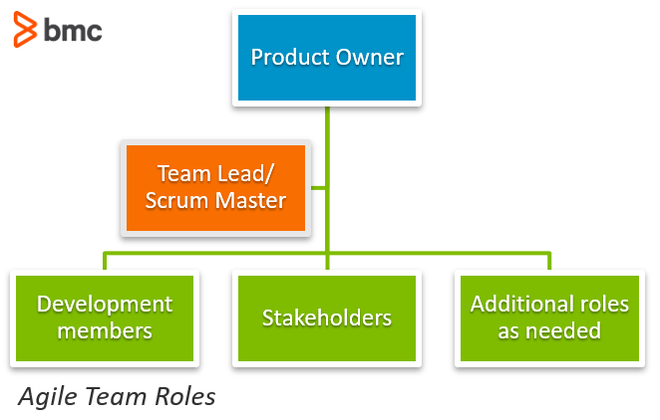
Agile Roles
Product Owner
Scrum Master
The Product Owner (PO) is the one responsible for the process of the project.
RESPONSIBILITIES:
Creating the Product backlog.
Communication between team, executives, Stakeholders/users, and clientele
Delivering project updates continuously
The Scrum Master (SM) keeps the rest of the Agile team organized and on track.
RESPONSIBILITIES:
Coordinates Daily scrum and communication efforts between team and stakeholders Administers changes needed throughout each spRINT
Promotes Self-Organization and coaches team members

Slide 3

Agile Roles
Developer(s)
Tester
responsible for Developing altered product for each sprint with given requirements.
Responsibilities:
Communication with Product Owner about upcoming DeaD -lines and usage of the backlog Interactions with users/stakeholders to better understand their needs.
Could be a team who works in providing unique ideas and designs
Delivering project updates Continuously
THE Tester’s Role is seen through their collaboration with the PO, developers, and stakeholders, making sure the product matches the criteria.
Responsibilities:
Regression testing for each set of product outputs
Interactions with users/stakeholders to better understand their needs.
Reports bugs and flaws, providing updates to the Developer
Everyone could be considered

Slide 4

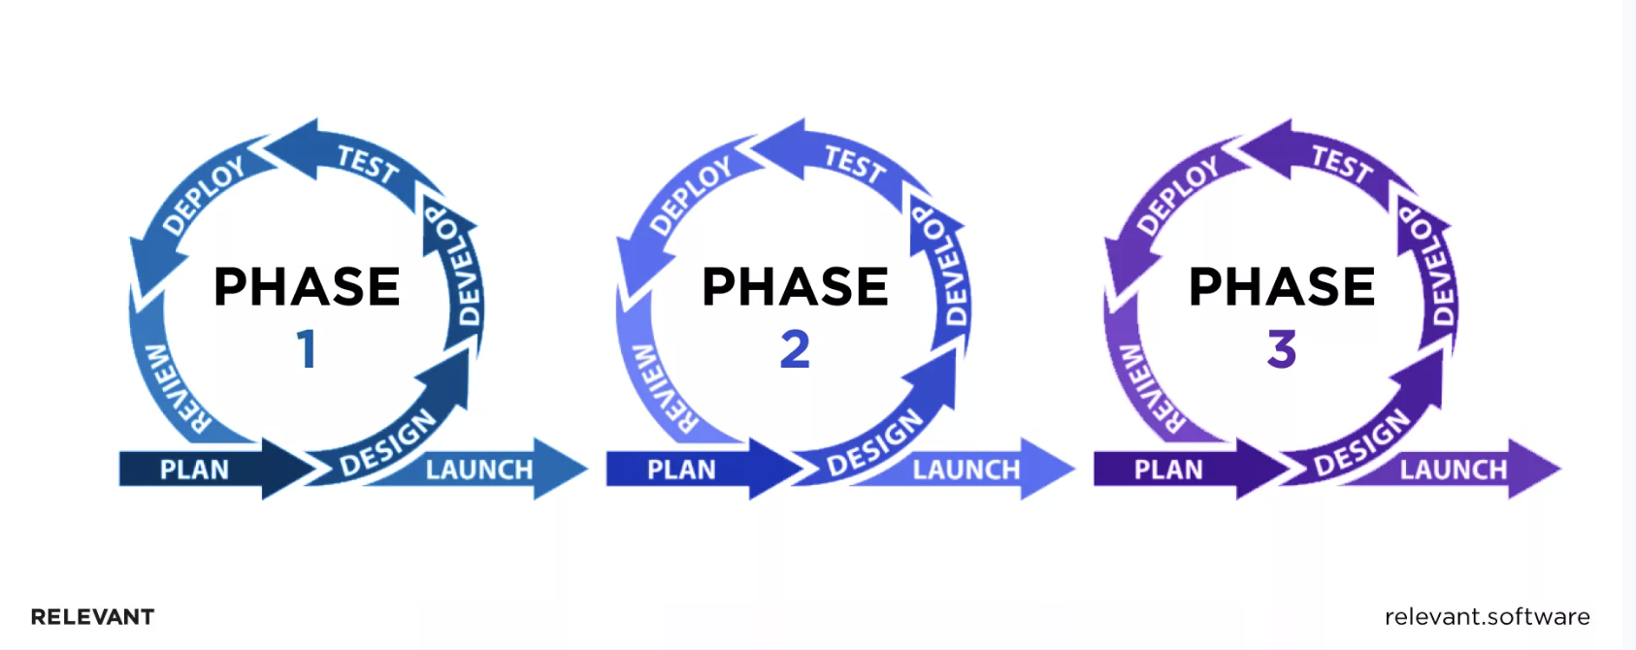
Agile MODEL
THE AGILE Framework is an adaptive approach where the stages of this model Grant team members the ability to adapt to the product requirements and even adopt a model that best suits the project
Agile is done incrementally, and rather than a method, Agile is composed of sprints where product is continuously produced
The level of planning will alternate for each agile project

Slide 5
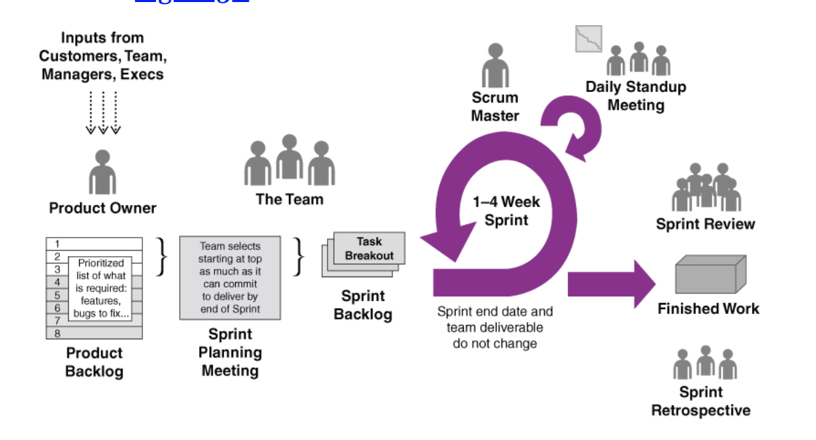
Phases for scrum
Sprint planning
This is the initial phase where the product owner will gather as much information as possible. The product owner will also complete the product backlog for the team which will help In creating a plan for the rest of the team, such as refining timelines and understanding the lengths in each sprint.
This is a vital phase where Agile principles are elaborated on for the team.
In this stage the definition of done will be defined.
The Team will ALSO create a Sprint goal in this stage, which will be the the Finished work launched at the end.
Daily Scrum
This phase of in the SCRUM-AGILE will take place every day throughout the entire work process, where the team is able to have an opportunity to gain an understanding on the projects process.
This time is allotted for a short period of time (~15 minutes) where members focus on what more they can accomplish and discern what their next steps are.
The team will work together in staying on topic and keeping conversations moving.

Slide 6
Phases for scrum
3. Sprint Review
The Sprint Review is literally a review session, where the team comes together (semi-frequently), usually at the end of each sprint to go over their work.
The Team will inspect ‘what went well?’, ‘what didn’t?’, and they will create ideas to implement, adapting to the needs of the project.
During this phase, the product backlog may Change, and the team will begin to work on what else is expected from them.
4. Sprint Retrospective
The Sprint retrospective is the last ‘phase’ of the scrum agile method, which Gives the team an opportunity to look back at the project and once again discuss the pros and cons of what happened.
The sprint retrospectives gets insight from the Scrum team, so they can identify how to better their model. This allows for growth, increasing the effectiveness of the team.

Slide 7

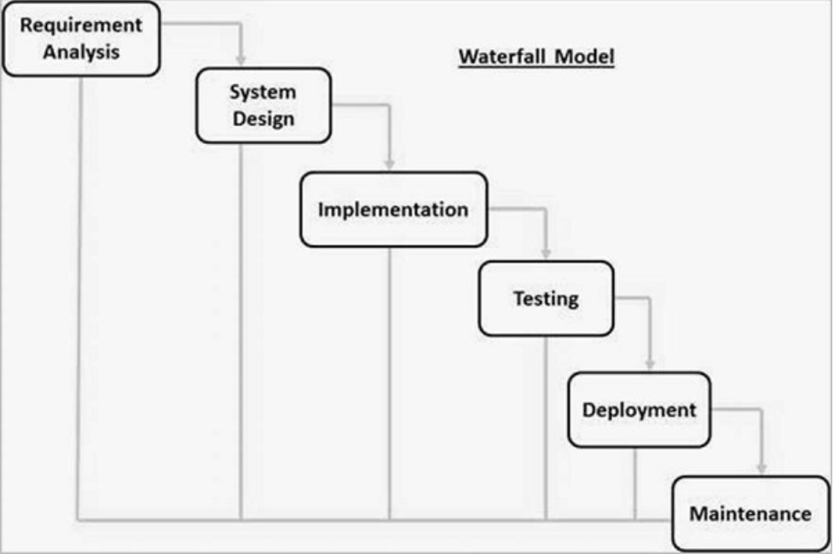
SNHU TRAVEL WITH WATERFALL
~ let us examine how the SDLC process would have worked using the Waterfall methodology
WATERFALL BEING A LINEAR AND SEQUENTIAL PROCESS
1a. Beginning with ‘Requirement Analysis’ we would have to have all the system requirements within this first push which was not the case.
1B.- We would have run into an issue as there was other requirements thrown into our project halfway through where we had to switch from a list view to a slideshow view.
the waterfall method pushes us through these phases, seen in the photo in the right, where we would not have the opportunity to go back and change our design, and our user stories, as Quickly and produce the system that our stakeholder’s had asked of us.

Slide 8
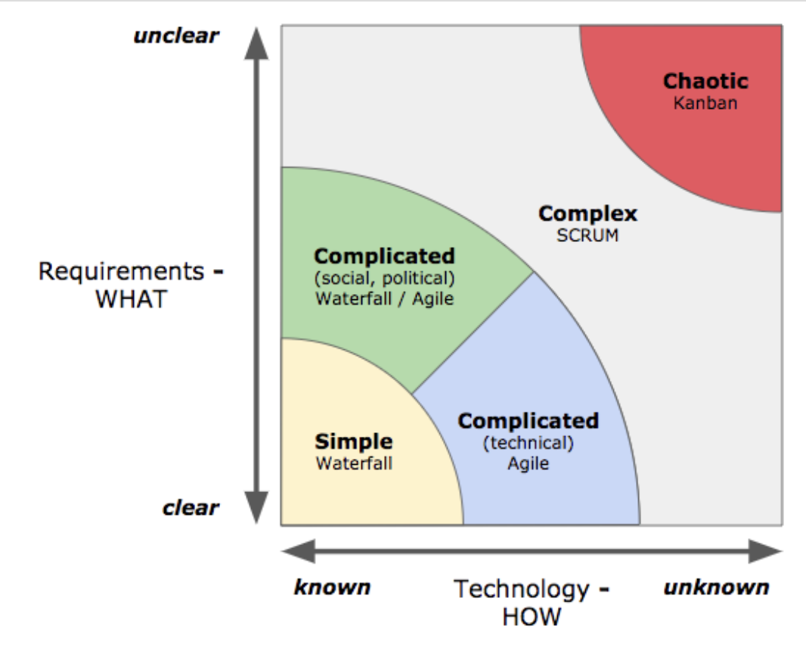
What do I use?
Do you have clear and precise requirements?
Is the project short and well defined?
Are there concrete and solid timeframes for the final product?
Are you looking for highly documented steps?
- If the answer is yes to the questions above; the waterfall method would suit your team the best!! The waterfall method is a linear process where goals are easily met when they are based on this criteria. They are great for small, easily understood, and well defined projects.

Slide 9
What do I use?
Do you have unclear requirements with many holes?
Is the project large, complex and Complicated?
Are there undefined constraints?
Do you have a larger economical wallet?
- If the answer is yes to the questions above; the Agile method would suit your team the best!! The agile method implements changes where the model can adapt as frequently as the project does. Agile is great for undefined projects with a large and unclear scope.

Slide 10
Citations
13, M., & Raza, M. (2019, May 13). Agile Roles & Responsibilities. BMC Blogs. https://www.bmc.com/blogs/agile-roles-responsibilities/#:~:text=The%20key%20responsibilities%20of%20the,peers%20and%20the%20Scrum%20Master.
Dziuba, A. (2023, April 6). Navigating the agile software development life cycle: Phases, tools, roadmap. Relevant Software. https://relevant.software/blog/agile-software-development-lifecycle-phases-explained/
harles G. Cobb. (2015). The Project Manager’s Guide to Mastering Agile : Principles and Practices for an Adaptive Approach. Wiley.
Maretzke, M. (2019, March 11). When to use waterfall, when agile? - in agile-minds.com. agile. https://www.agile-minds.com/when-to-use-waterfall-when-agile/

Slide 11
Citations
SDLC - Waterfall Model. Online Courses and eBooks Library. (n.d.). http://www.tutorialspoint.com/sdlc/sdlc_waterfall_model.htm
Shiklo, B. (2019, November 25). How to build a software development team and set efficient team processes. ScienceSoft footer icon. https://www.scnsoft.com/blog/software-development-team
Software Testing Roles and Responsibilities. International Software Test Institute. (n.d.). https://www.test-institute.org/Software_Testing_Roles_And_Responsibilities.php#:~:text=Test%20engineers%2FQA%20testers%2FQC%20testers%20are%20responsible%20for%3A&text=Develop%20test%20cases%20and%20prioritize,the%20code%20to%20fix%20defects.
West, D. (n.d.). Agile Scrum roles. Atlassian. https://www.atlassian.com/agile/scrum/roles

